Slide 1


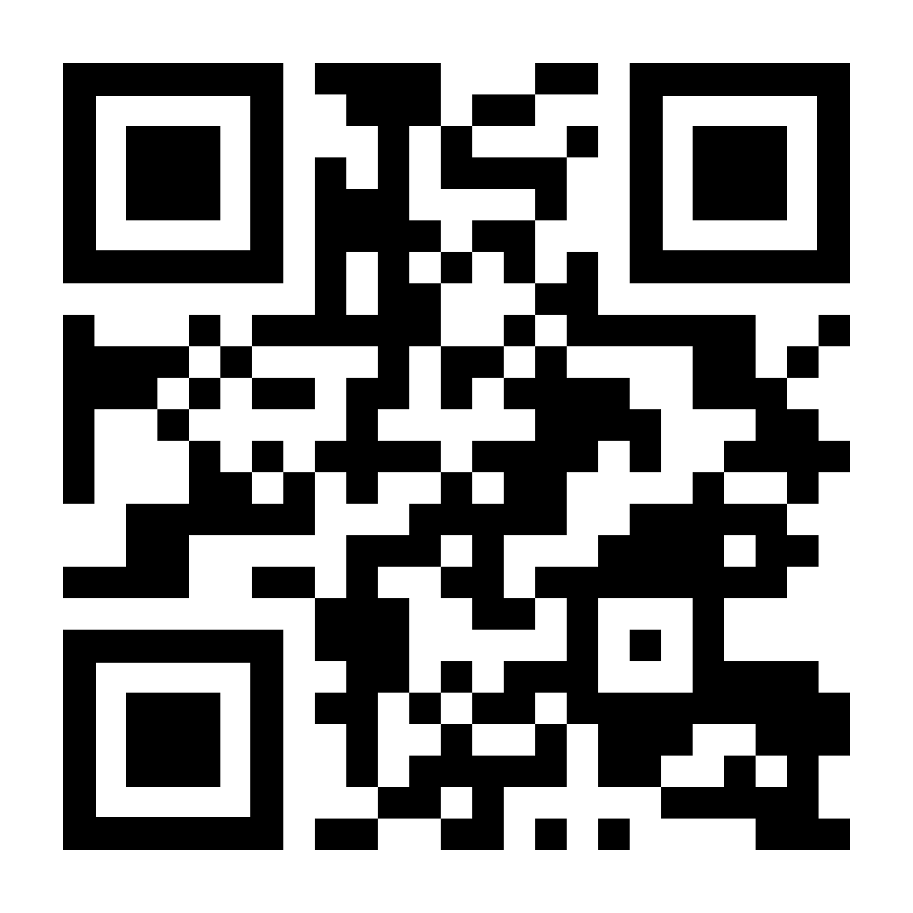
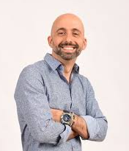

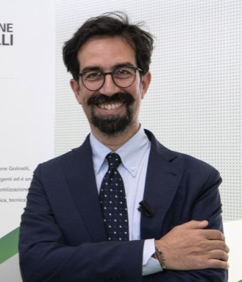

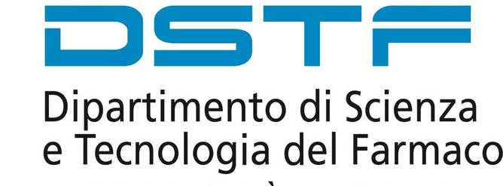
DOCTORAL PROGRAM
IN PHARMACEUTICAL SCIENCES
Location: Aula A Dipartimento di Scienze Farmaceutiche
HYBRID
Team Platform link: https://rb.gy/802xx4
QR Code:
Timetable: March 11, 2026 15:00-17:00
15:00-15:45
“Lactic acid bacteria in animal production”
Prof. Giuseppe Meca de Caro
University of Valencia
Department of Preventive Medicine and Public Health, Food Sciences, Toxicology and Legal Medicine
16:00-16:45
“Redesigning the bioisosteric tool: targeting Dihydroorotate Dehydrogenase (hDHODH) and other fluorescent stories”
Prof. Marco Lucio Lolli
University of Turin
Department of Science and Technology of Drug

